Slide 1
DLB: Dynamic Load Balancing Library
Marta Garcia-Gasulla
Victor Lopez
November 2021
Tutorial

Slide 2
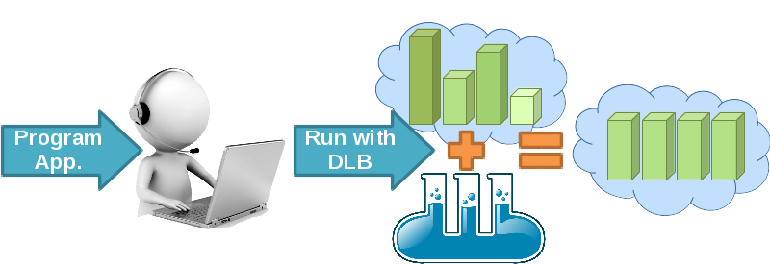
Dynamic Load Balancing - DLB
Our objectives:
Address all sources of imbalance
Fine Grain, dynamic…
How?
Detect imbalance at runtime
React immediately
Real product for HPC
Use common programming model/environment
MPI + OpenMP
Transparent to the application
Runtime library

Slide 3
DLB structure
Three modules:
LeWI: For fine grain load balancing
DROM: For coarse grain resource management
TALP: For performance measurement
Common infrastructure
Integration with different layers of software stack
API
Shared memory
Three modules, integrated but independent
CPU status
App.
API
LeWI
Job Sched.
MPI
DROM
Shared Mem.
PMPI
OpenMP
OmpSs
OS
Process status
OMPT
TALP
HW

Slide 4
DLB integration
Integration with different layers:
Application: DLB offers a user-level API
Job Scheduler: DLB offers an API for resource managers
MPI: PMPI interception
OpenMP: OMPT interception, few OpenMP runtimes support it or API added by user
OmpSs: Runtime integration with DLB library, the OmpSs runtime calls the DLB library
CPU status
App.
API
LeWI
Job Sched.
DLB offers mechanisms to be transparent to the application/user.
DLB API is useful for advanced users that have a good knowledge of their application.
Shared Mem.
MPI
PMPI
DROM
OpenMP
OmpSs
OS
Process status
OMPT
TALP
HW

Slide 5
DLB: Main concepts
CPU (core): Minimum computing unit acknowledged by DLB, where one thread (and only one at the same time) can run.
Idle CPU: A CPU that is not being used to do useful computation.
Owner: Process that owns a CPU. A process owns the resources where it is started. A CPU can only be owned by one process at the same time.
Lend: When the owner of a CPU is not using it, the CPU can be lent to the system. When a CPU is lent, a process that it is not its owner can use it.
Claim: When the owner of a CPU wants to use it after lending it, the owner can claim the CPU.
Ask for Resources: A process of the system can ask DLB for idle CPUs to speed up its execution.

Slide 6
LeWI Lend When Idle

Slide 7
Lend When Idle (LeWI)
The idea: Use computational resources of a process when not using them to speed up another process in the same node
HPC Appl.
DLB
MPI 1
MPI 2
Shared Memory
cpu1
cpu2
cpu3
cpu4
Idle cpus
Borrow
Lend 2 cpus
2
4
Lend 4 cpus
cpu1
cpu2
MPI call
MPI call
Decentralized, communication is done through shared memory
LeWI a runtime balancing algorithm for nested parallelism. In Proceedings of International Conference of Parallel Processing (ICPP 2009).

Slide 8
LeWI: Implementation
MPI interception: Use standard PMPI interception avoids recompiling, DLB can be used with LD_PRELOAD.
Second level of parallelism: We need shared memory parallelism. Current version supports OmpSs and OpenMP.
Must be malleable. Lack of malleability limits performance
Malleability can be limited by the programming model or the application.
OpenMP: Three levels/options of integration:
API: Works with any OpenMP implementation, must modify the code and link with DLB.
OMPT: Only works with OpenMP implementations implementing OMPT.
Free agents: Works preloading our own version of OpenMP implementation (LLVM based)
OmpSs: Fully integrated with DLB, high malleability.

Slide 9
LeWI: Malleability vs. Programming Model
OpenMP
Fork-join model
Can only change number of threads outside parallel region
OmpSs
Task based model
Can change number of threads at any point
A thread can not leave a task unfinished
OpenMP
Single parallel region
OpenMP
Multiple parallel regions
OmpSs
OpenMP
Free agent threads
Main
OMP PARALLEL
OMP PARALLEL DO
OMP PARALLEL
OMP DO
T
Task
T
T
TASK
TASK
TASK
TASK
T
T
TASK
OMP PARALLEL DO
T
T
TASK
TASK
TASK
OMP DO
Can adjust threads
T
T
TASK
T
T
TASK
TASK
TASK
OMP PARALLEL DO
T
T
T
TASK
TASK
T
TASK
TASK
OMP DO
TASK
TASK
TASK
Number of threads can be changed

Slide 10
OpenMP: Malleability
OpenMP is malleable, we can change number of threads
omp_set_num_threads(int x)
But only outside a parallel region
But some programming practices can avoid malleability:
Program in function of the thread Id
omp_get_thread_num(int x)
Fear if you see this call!
Do reductions “by hand”
Allocate memory in function of the number of threads and each one will reduce in its piece of data.
Avoid these practices please!

Slide 11
OpenMP/OmpSs Summary
 | OpenMP | OpenMP + OMPT | OpenMP + free agent | OmpSs
CPU binding | No supported | Rebind through OMPT | Yes | Yes
Malleability | Only outside parallel regions | Only outside parallel regions | Malleability through tasking | Yes
Integration | Add DLB_borrow before each parallel region + LD_PRELOAD | LD_PRELOAD | LD_PRELOAD | Transparent, integrated through OmpSs

Slide 12
Success Story 1: ParMMG
Parallel mesh adaptation of 3D volume meshes. High imbalance and changing between iterations. Pure MPI code
Added OmpSs parallelization to one loop + 1 call to DLB API.
1.2x Speedup overall execution.

Slide 13
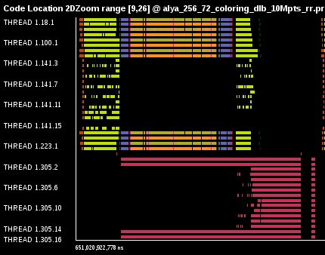
Success Story 2: Alya coupled codes
Respiratory simulation coupling 2 codes: Fluid + particle tracking
Zoom in 1 node with DLB
3 Actions:
Load Balance Fluid
Load Balance Particles
Load Balance 2 codes
Original
With DLB

Slide 14
LeWI API
int DLB_Enable(void);
Enable DLB and all its features in case it was previously disabled otherwise it has no effect
int DLB_Disable(void);
Disable DLB actions for the calling process.
int DLB_SetMaxParallelism(int max);
Set the maximum number of resources to be used by the calling process.
int DLB_UnsetMaxParallelism(void);
Unset the maximum number of resources to be used by the calling process.
int DLB_Lend(…);
Lend current CPUs
Int DLB_Reclaim(…);
Reclaim CPUs owned by the process
int DLB_AcquireCpu(…);
Acquire a specific CPU, equivalent to Reclaim if the process it the owner and to Borrow if not.
int DLB_Borrow(…);
Borrow possible CPUs registered on DLB
int DLB_Return(…);
Return claimed CPUs of other processes
int DLB_Barrier(void);
Barrier between processes in the node
These functions have 4 different versions:
void: Any CPU.
int CPU_Id: the specified CPU
int num_CPUs: the amount of CPUs indicated
CPUmask: the CPUs indicated in the mask

Slide 15
DROM Dynamic Resource Ownership Management

Slide 16
DROM: Dynamic Resource Ownership Management
API for superior entity
Job Scheduler
Resource manager
User
Allow to change the owner of resources (CPUs)
By the process
By an external entity (Resource manager)
DROM: Enabling Efficient and Effortless Malleability for Resource Managers. In Proceedings of International Conference on Parallel Processing (ICPP 2018)

Slide 17
DROM: Dynamic Resource Ownership Management
App.
MPI1
MPI2
cpu1
cpu2
cpu3
cpu4
RM
DLB_DROM_Attach
CPU status
Shared Mem.
DROM
setProcessMask
Process status
setProcessMask
cpu1

Slide 18
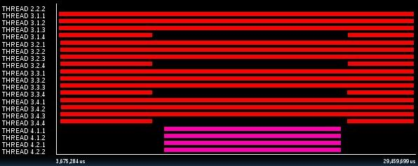
DROM: Use cases
A) User: Increase priority to App2
B) Job Scheduler: Run High priority App2 in resources assigned to App1
C) App1: Release 2 CPUs because not using efficiently
App2
App1
App2
App1
App1

Slide 19
DROM: How to
7
6
5
4
3
2
1
0
A)
$> dlb_taskset -p pid_app2 –c 0-5
B)
$> dlb_taskset –c 0,1 ./App2
C)
DLB_DROM_SetProcessMask(my_pid, [0,0,1,1]);
App2
App1
App2
App1
App1

Slide 20
DROM API
int DLB_DROM_Attach(void);
Attach current process to DLB system as DROM administrator
int DLB_DROM_Detach(void);
Detach current process from DLB system
int DLB_DROM_GetNumCpus(int *ncpus);
Get the number of CPUs in the node
int DLB_DROM_GetPidList(int *pidlist, int *nelems, int max_len);
Get the list of running processes registered in the DLB system
int DLB_DROM_GetProcessMask(int pid, dlb_cpu_set_t mask, dlb_drom_flags_t flags);
Get the process mask of the given PID
int DLB_DROM_SetProcessMask(int pid, const_dlb_cpu_set_t mask, dlb_drom_flags_t flags);
Set the process mask of the given PID
int DLB_DROM_PostFinalize(int pid, dlb_drom_flags_t flags);
Unregister a process from the DLB system

Slide 21
TALP Tracking Application Low-level Performance

Slide 22
TALP: Tracking Application Live Performance
Profiling tool with:
Low overhead
Report POP metrics
API to obtain metrics at runtime
API to instrument code and profile regions of code
Current version profiles MPI performance
TALP a lightweight tool to Unveil Parallel Efficiency of Large Scale Executions. In Proceedings of Performance Engineering, Modelling, Analysis, and Visualization Strategy (Permavost 2021).

Slide 23
TALP
App.
MPI1
MPI2
cpu1
cpu2
cpu3
cpu4
MPI call
Process status
PMPI
MPI call
PMPI
Process status
Compute time
TALP
Compute time
TALP
MPI time
API
get_metrics
get_metrics
API
MPI time
MPI Finalize
MPI Finalize

Slide 24
Why is more than “yet another profiling tool”?
A profiler will report same “issue” while both cases have very different problems.
TALP will report a low Load Balance for App A and a low Communication efficiency for App B
App. A
App. B
MPI1
MPI2
MPI1
MPI2
cpu3
cpu4
MPI call
MPI call
cpu1
cpu2
MPI call
cpu1
cpu2
cpu3
cpu4
MPI call
MPI call
MPI call
MPI call
MPI call
MPI call
MPI call
MPI call
MPI call
MPI call
MPI call
MPI call
MPI call

Slide 25
Using TALP
At finalization
At runtime
# include < dlb_talp .h >
...
// Register a new region or obtain an existing handler
dlb_monitor_t * monitor = DLB_MonitoringRegionRegister (“Name”);
// Start TALP monitoring region
DLB_MonitoringRegionStart( monitor );
...
// Stop TALP monitoring region
DLB_MonitoringRegionStop( monitor );
...
// Print a report by standard output
DLB_MonitoringRegionReport( monitor );
...
// Manually obtain some metrics from the monitor
int64_t elapsed = monitor->elapsed_time;
int64_t elapsed_use =monitor->elapsed_computation_time;
float comm_eff = ( float ) elapsed_use / elapsed ;
DLB_ARGS=" --talp [--talp-summary=pop-metrics]"
env LD_PRELOAD="$DLB_LIBS/libdlb_mpi.so" ./app

Slide 26
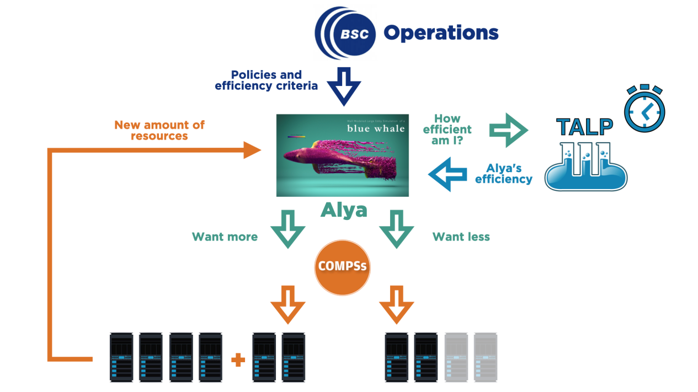
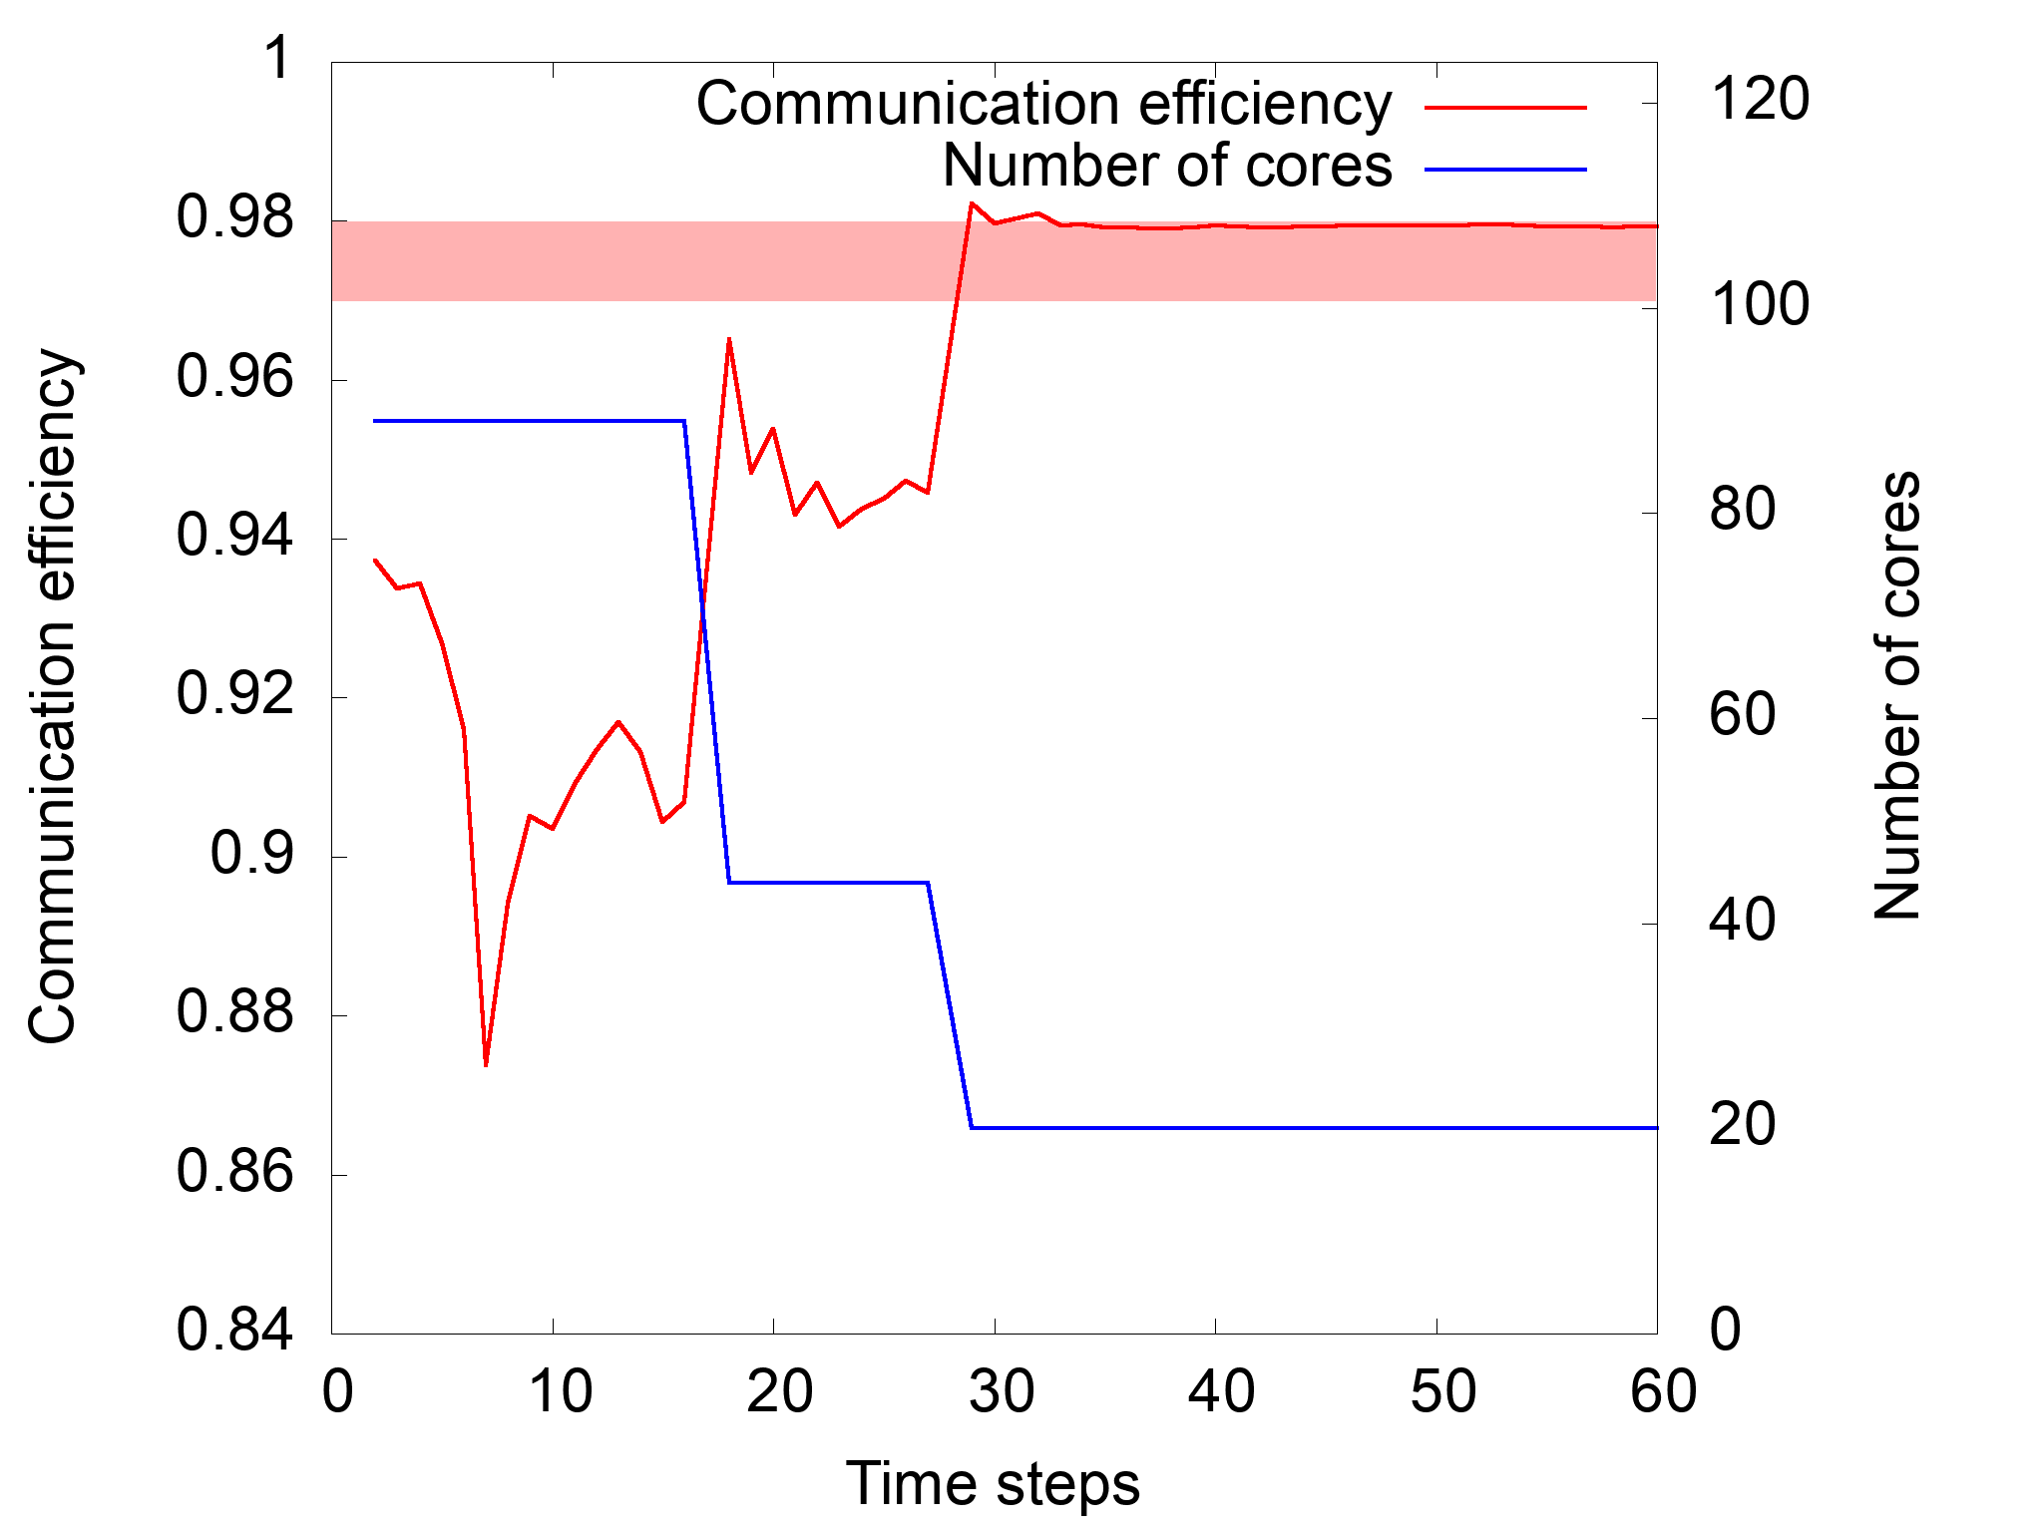
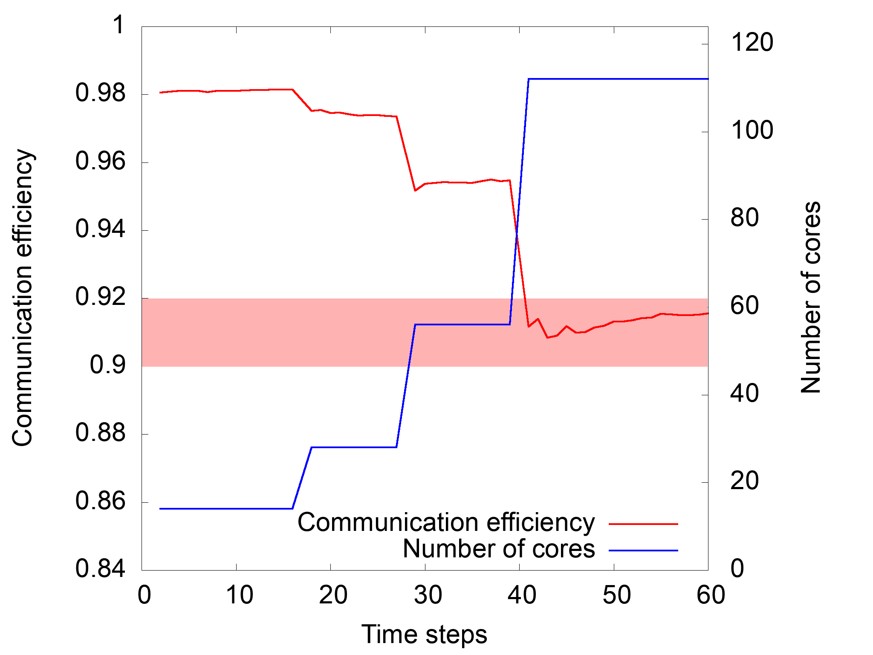
Success story 3: Malleable simulation
Application that adjust number of resources used based on measures by TALP

Slide 27
About DLB
Current stable version 3.0 (January 2021)
LeWI
DROM
TALP
Work in progress and future work:
Free-agent implementation
Extend TALP to report OpenMP metrics
Integration with OmpSs@Cluster
Free Download under LGPL-v3 license: https://pm.bsc.es/dlb-downloads
User Guide: https://pm.bsc.es/ftp/dlb/doc/user-guide/

Slide 28
Looking for cooperation…
Applications
With load issues, not only imbalances, changing loads, resources needs based on load…
Runtimes to integrate with DLB.
Schedulers or Resource managers to integrate with DROM or TALP

Slide 29
Thank you
marta.garcia@bsc.es
victor.lopez@bsc.es
https://pm.bsc.es/dlb

